Slide 1
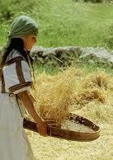

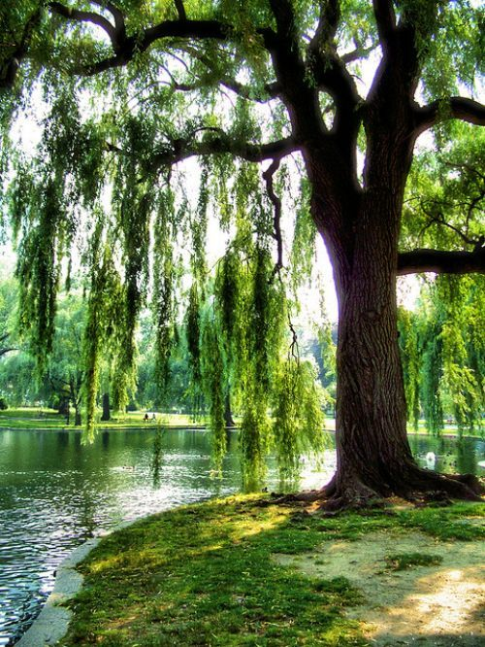
The Blessings of Choosing Wisely
Encounter Service 9 Sep 2017
Cecil Ang

Slide 2
INTRODUCTION
Mankind created with the capacity to make choices
And the Lord God commanded the man, saying, “You may surely eat of every tree of the garden, but of the tree of the knowledge of good and evil you shall not eat, for in the day that you eat of it you shall surely die.” Gen 2:16-17 ESV

Slide 3
THE BOOK OF PSALMS
  Collection of inspired Hebrew prayers and songs – words spoken to God and about God
  Purpose why it is included in the canon of Scripture – it helps us
    To express ourselves to God
    To consider the ways of God
Tehillim (Heb) means “praises”
Psalmoi (Gk) means “twangings (of harp strings)”

Slide 4
THE BOOK OF PSALMS
Hebrew poetry is known for parallelism (not so much of meter & rhyme):
  Synonymous: a literary device involving the repetition of one idea in successive lines.
  Antithetical: brings together opposing ideas in marked contrast.
Psalm 1 opens the book with the blessings of meditating on God’s Word (with implied obedience)

Slide 5
PSALM 1 (ESV)
¹ Blessed is the man
who walks not in the counsel of the wicked,
nor stands in the way of sinners,
nor sits in the seat of scoffers;
² but his delight is in the law of the Lord,
and on his law he meditates day and night.

Slide 6
PSALM 1 (ESV)
³ He is like a tree
planted by streams of water
that yields its fruit in its season,
and its leaf does not wither.
In all that he does, he prospers.
⁴ The wicked are not so,
but are like chaff that the wind drives away.
⁵ Therefore the wicked will not stand in the judgment,
nor sinners in the congregation of the righteous;
⁶ for the Lord knows the way of the righteous,
but the way of the wicked will perish.

Slide 7
A STARK CONTRAST PRESENTED
Portrait of the Righteous/Wise | Portrait of the Wicked/Fool
What he does not do (v 1) Walks not in the counsel of the wicked (loose morals) Stands not in the way of sinners (missed God’s standard) Sits not in the seat of scoffers (put down the things of God) | What he does Follows/heeds the advice of the devil (thoughts) Identifies or shares in the rebellion against God (actions) Judges based on the perspective of those bearing cynicism and pride (lifestyle)

Slide 8
A STARK CONTRAST PRESENTED
Portrait of the Righteous/Wise | Portrait of the Wicked/Fool
What he does not do (v 1) Walks not in the counsel of the wicked (loose morals) Walk in a manner worthy of the calling … with all humility and gentleness, with patience, bearing with one another in love, eager to maintain the unity of the Spirit in the bond of peace. Eph 4:1-3 ESV | What he does Follows/heeds the advice of the devil; controlled by the flesh rather than the Spirit & Word For jealousy and selfishness are not God’s kind of wisdom. Such things are earthly, unspiritual, and demonic. Jas 3:15 NLT “You will not surely die. For God knows that when you eat of it your eyes will be opened, and you will be like God, knowing good and evil.” Gen 3:4-5 ESV

Slide 9
A STARK CONTRAST PRESENTED
Portrait of the Righteous/Wise | Portrait of the Wicked/Fool
What he does not do (v 1) Stand not in the way of sinners (fall short of God’s standards) Enter by the narrow gate. For the gate is wide and the way is easy that leads to destruction, and those who enter by it are many. For the gate is narrow and the way is hard that leads to life, and those who find it are few. Mt 7:13-14 ESV | What he does Identify or share in the rebellion against God; from thinking to acting like the world Woe to them! For they walked in the way of Cain and abandoned themselves for the sake of gain to Balaam's error and perished in Korah's rebellion. Jude 1:11 ESV

Slide 10
A STARK CONTRAST PRESENTED
Portrait of the Righteous/Wise | Portrait of the Wicked/Fool
What he does not do (v 1) Sit not in the seat of scoffers (put down the things of God) Do you not know that the saints will judge the world? And if the world is to be judged by you, are you incompetent to try trivial cases? Do you not know that we are to judge angels? 1 Cor 6:2-3 ESV | What he does Judge based on the perspective of those bearing cynicism and pride Scoffers will come in the last days with scoffing, following their own sinful desires. They will say, “Where is the promise of his coming? For ever since the fathers fell asleep, all things are continuing as they were from the beginning of creation.” 2 Pet 3:3-4 ESV

Slide 11
A STARK CONTRAST PRESENTED
Portrait of the Righteous/Wise | Portrait of the Wicked/Fool
What he does (v 2) Delight in the law of God Meditate on the law day & night (to internalise & apply Scripture) | What he does not do Believe not in God’s existence Rely not on God’s guidance

Slide 12
A STARK CONTRAST PRESENTED
Portrait of the Righteous/Wise | Portrait of the Wicked/Fool
What he does (v 2) Delight in the law of God; to bend or incline toward God’s law Your testimonies are my delight; they are my counsellors. Ps 119:124 ESV | What he does not do Believe not in God’s existence The fool says in his heart, “There is no God.” They are corrupt, they do abominable deeds; there is none who does good. Ps 14:1 ESV

Slide 13
A STARK CONTRAST PRESENTED
Portrait of the Righteous/Wise | Portrait of the Wicked/Fool
What he does (v 2) Meditate on the law day & night; (to utter sounds, to speak) This Book of the Law shall not depart from your mouth, but you shall meditate on it day and night, so that you may be careful to do according to all that is written in it. For then you will make your way prosperous, and then you will have good success. Josh 1:8 ESV | What he does not do Does not follow God’s law Hot indignation seizes me because of the wicked, who forsake your law. Ps 119:54 ESV The insolent have dug pitfalls for me; they do not live according to your law. Ps 119:85 ESV

Slide 14
A STARK CONTRAST PRESENTED
Portrait of the Righteous/Wise | Portrait of the Wicked/Fool
What he is liken to (v 3) A tree planted by streams of water (Word/Spirit) Fruitful in its season (trophies/ graces) Leaf does not wither (durable) Prospers in whatever he does | What he is liken to (v 4) Not so, the wicked Chaff driven by the wind (unstable, unfruitful, not dependable and w/o success)

Slide 15
Education in Jesus’ Time
Age | Fit for
5 | Scripture (reading, writing, memorisation; Lk 2:52)
10 | Mishnah (Oral Torah)
13 | Fulfilling of the Commandments (Bar Mitzvah; Lk 2:49)
15 | Talmud (Gemara: Rabbinic interpretations of Scripture)
18 | The Bride-chamber
20 | Pursuing a vocation (Mk 6:3)
30 | Authority (able to teach others)

Slide 16
Deut 21:18-21 ESV
¹⁸ “If a man has a stubborn and rebellious son who will not obey the voice of his father or the voice of his mother, and, though they discipline him, will not listen to them, ¹⁹ then his father and his mother shall take hold of him and bring him out to the elders of his city at the gate of the place where he lives, ²⁰ and they shall say to the elders of his city, ‘This our son is stubborn and rebellious; he will not obey our voice; he is a glutton and a drunkard.’ ²¹ Then all the men of the city shall stone him to death with stones. So you shall purge the evil from your midst, and all Israel shall hear, and fear.
Others: Sabbath observance; who is my neighbour?

Slide 17
A STARK CONTRAST PRESENTED
Portrait of the Righteous/Wise | Portrait of the Wicked/Fool
Final Outcome (v 6) Known by God (keeps on knowing) – receives His care, guidance and approval on a continual basis | Final Outcome (v 5-6) Will not stand in the judgment Will perish – separated from God Condemnation is ready for scoffers, and beating for the backs of fools. Pr 19:29 ESV But when I thought how to understand this, it seemed to me a wearisome task, until I went into the sanctuary of God; then I discerned their end. Ps 73:16-17 ESV

Slide 18
The Obedience of the 2nd Adam
For as by the one man's disobedience the many were made sinners, so by the one man's obedience the many will be made righteous. Rom 5:19 ESV
Blessed be the God and Father of our Lord Jesus Christ, who has blessed us in Christ with every spiritual blessing in the heavenly places Eph 1:3ff ESV

Slide 19
QUOTES
Our lives are a sum total of the choices we have made. Wayne Dyer
Some of our important choices have a time line. If we delay a decision, the opportunity is gone forever. Sometimes our doubts keep us from making a choice that involves change. Thus an opportunity may be missed. James E. Faust
The meaning of life. The wasted years of life. The poor choices of life. God answers the mess of life with one word: 'grace.' Max Lucado

Slide 20
APPLICATIONS
1. What do you need to focus on today so that you can experience the prosperity God desires for you?
2. How can you determine the right decision to make at each crucial junction of your life? Check your values/attitudes and behaviours.
Wise | Foolish
Humility, Gentleness, Patience | Jealousy, Selfishness (Pride)
Maintain the unity of the Spirit in the bond of peace | Causing hurt/grief to others or oneself

